Slide 1

TAMSAT Amateur Satellite Technologies Organization (2010)
Burcu AYBAK
General Secretary
Barış DİNÇ
Vice President (Engineering)

Slide 2


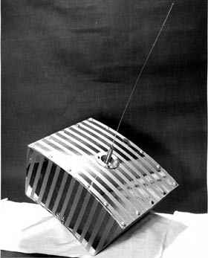

The Radio Amateur Satellite Corporation (as AMSAT is officially known) was first formed in the District of Columbia in 1969 as an educational organization. Its goal was to foster Amateur Radio’s participation in space research and communication. AMSAT was founded to continue the efforts, begun in 1961, by Project OSCAR , a west coast USA-based group which built and launched the very first Amateur Radio satellite, OSCAR, on December 12, 1961, barely four years after the launch of Russia’s first Sputnik.
Notes:
The Radio Amateur Satellite Corporation (as AMSAT is officially known) was first formed in the District of Columbia in 1969 as an educational organization. Its goal was to foster Amateur Radio’s participation in space research and communication. AMSAT was founded to continue the efforts, begun in 1961, by Project OSCAR , a west coast USA-based group which built and launched the very first Amateur Radio satellite, OSCAR, on December 12, 1961, barely four years after the launch of Russia’s first Sputnik.
Orbital Satellite Carrying Amatour Radio

Slide 3

For over 48 years AMSAT groups in North America and elsewhere have played a key role in significantly advancing the state of the art in space science, space education, and space technology.
Undoubtedly, the work now being done by AMSAT volunteers throughout the world will continue to have far-reaching, positive effects on the very future of both Amateur Radio, as well as other governmental, scientific and commercial activities in the final frontier.
Rarely have a group of “amateur” volunteers managed to do so much…for so many…with so little.
Notes:
For over 48 years AMSAT groups in North America and elsewhere have played a key role in significantly advancing the state of the art in space science, space education, and space technology.
Undoubtedly, the work now being done by AMSAT volunteers throughout the world will continue to have far-reaching, positive effects on the very future of both Amateur Radio, as well as other governmental, scientific and commercial activities in the final frontier.
Rarely have a group of “amateur” volunteers managed to do so much…for so many…with so little.

Slide 4
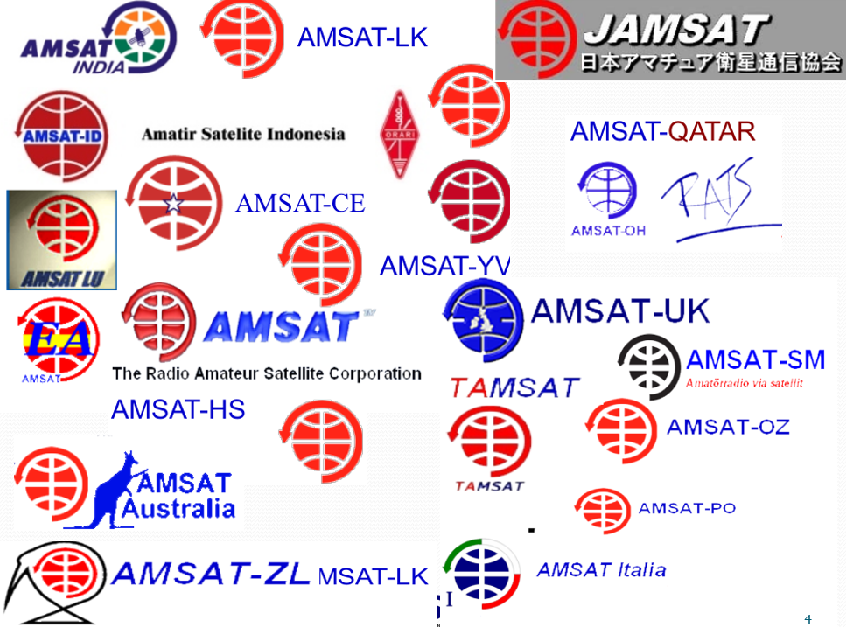
Notes:
These are some of the amsat organizations all over the world
Amsat avustralia
Amsat japan
Amsat newzelland
Amsat Italy
Amsat polonya
Amsat Indonesia
Amsat united kingtom
And also Tamsat from Turkey

Slide 5
TAMSAT
OUR MISSION:
Development, production and support of scientific amateur satellites,
Research and Development (R&D) activities of national satellites,
Education and Training support for satellites and space sciences,
Sharing information to be used by ham radio operators,
Organizing seminars and courses to increase the awareness of young people,
Coordination with the international organizations and coordinators.
Notes:
OUR MISSION:
Development, production and support of scientific amateur satellites,
Research and Development (R&D) activities of national satellites,
Education and Training support for satellites and space sciences,
Sharing information to be used by ham radio operators,
Organizing seminars and courses to increase the awareness of young people,
Coordination with the international organizations and coordinators.

Slide 6
TAMSAT
OUR VISION:
Supporting Turkish Youth to build national satellites and subsystems,
Importing required equipment and devices to support researches,
Coordinating the usage of amateur satellites to support disaster communications and public safety,
Equipment support for ham radio satellite ground stations operated by scout clubs, amateur radio clubs and search & rescue organizations.
Notes:
OUR VISION:
Supporting Turkish Youth to build national satellites and subsystems,
Importing required equipment and devices to support researches,
Coordinating the usage of amateur satellites to support disaster communications and public safety,
Equipment support for ham radio satellite ground stations operated by scout clubs, amateur radio clubs and search & rescue organizations.

Slide 7
Active Working Groups in TAMSAT
Project Management
CAD/CAM/Animation Team
Digital Payload Module Group
Amateur Satellite Integration and Test Team
Budget & Finance Team
Ground Stations and Monitoring Team
Regulation & Frequency Coordination Team
Structure Design Group
Software Design & Development Team
Antenna Design Group
Notes:
Project Management
CAD/CAM/Animation Team
Digital Payload Module Group
Amateur Satellite Integration and Test Team
Budget & Finance Team
Ground Stations and Monitoring Team
Regulation & Frequency Coordination Team
Structure Design Group
Software Design & Development Team
Antenna Design Group
Also we would like to cooperate with you in details of antenna and microwave designs. We are working with Türker Dolapçı who is a member of your group. On the other hand we are working with METU Günam which is in Physics department, to develop a Turkish solution for high efficient satellite solar panels.

Slide 8
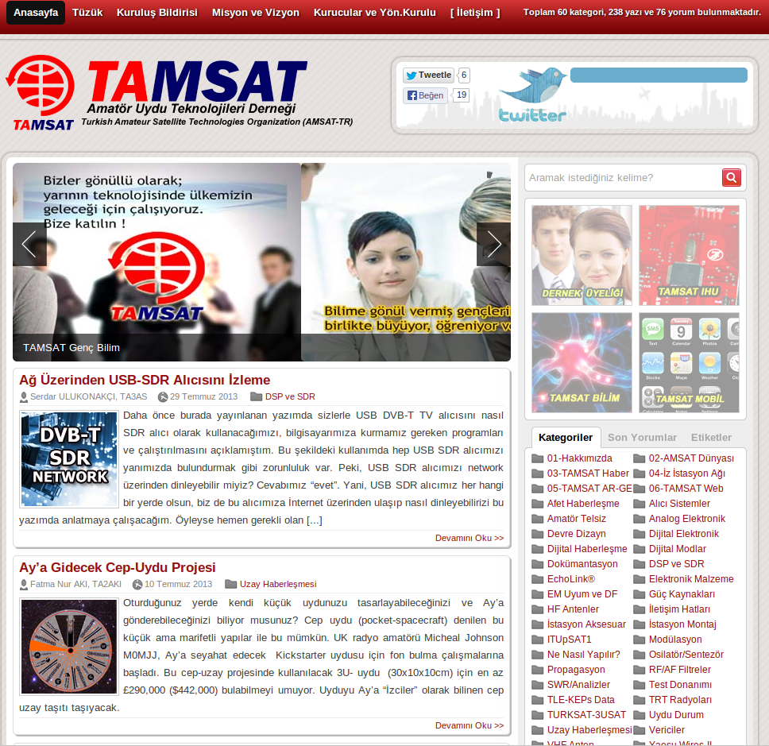
http://www.tamsat.org.tr
Notes:
www.tamsat.org.tr is our webpage where we share our all information.
You can find articals, documents and project details prepared or translated by our volunteers.
There are a lot of knowledge hidden in this web page.

Slide 9
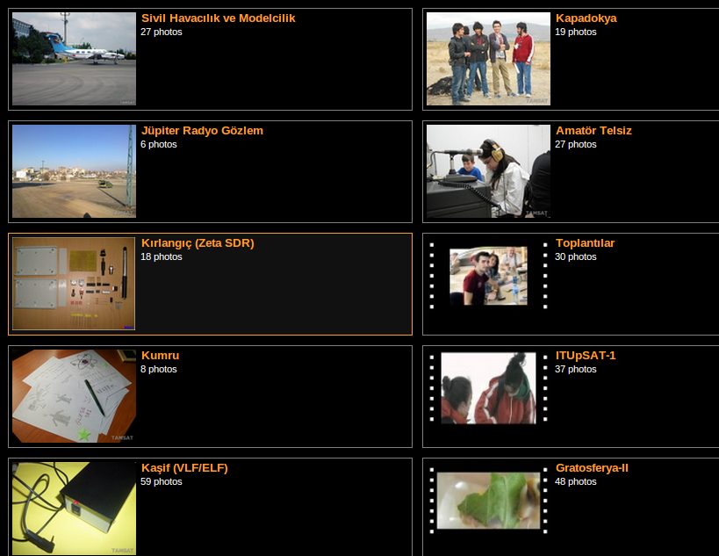
ACTIVITIES in TAMSAT
Notes:
I would like to mention some of the activities held by young tamsat members
They developed radios to observe Jupiter
They developed SDR to observe hidrojen in space
They monitored ITU psat-1 with home made antennas

Slide 10
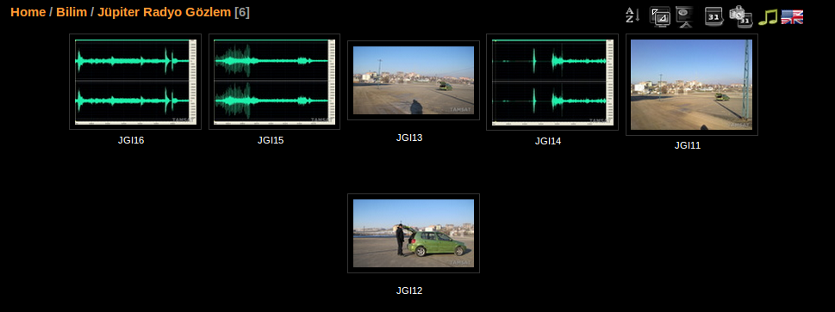
ACTIVITIES in TAMSAT
Notes:
These are some photos our archive about Jupiter observation with radio
The first steps of radio astronomy

Slide 11
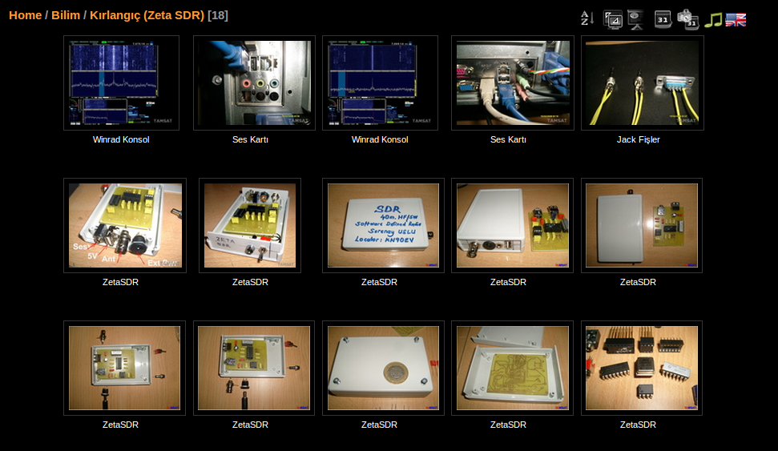
ACTIVITIES in TAMSAT
Notes:
This is another SDR project from our groups

Slide 12
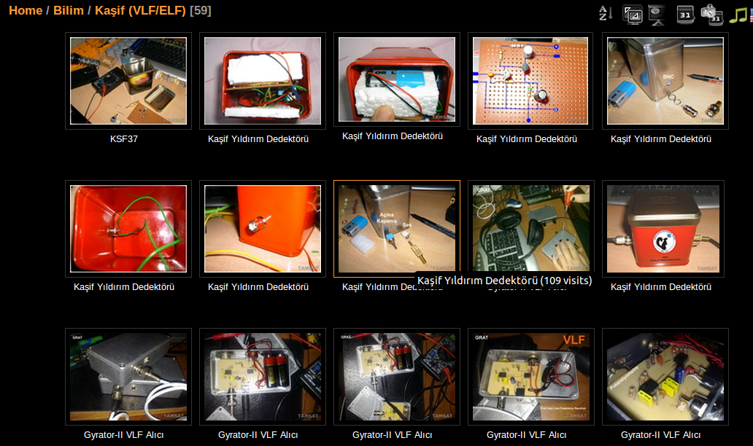
ACTIVITIES in TAMSAT
Notes:
This is the very Low Frequency Communication receiver project to listen earth waves

Slide 13
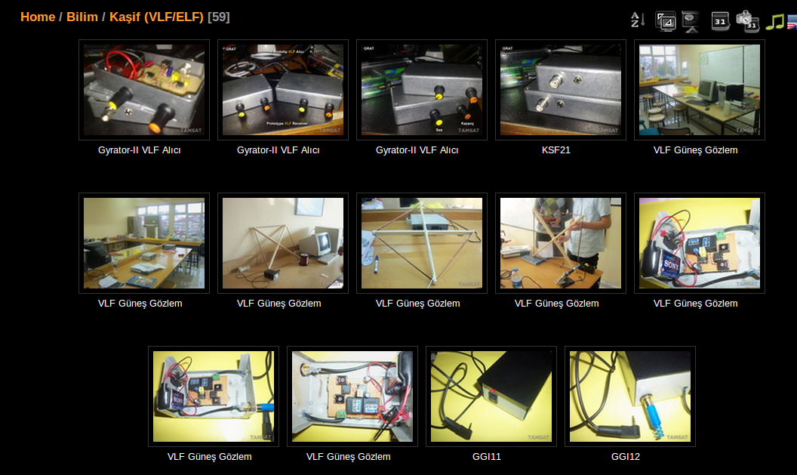
ACTIVITIES in TAMSAT
Notes:
Some other snapshots from Kaşif VLF/ELF activities and antenna designs

Slide 14
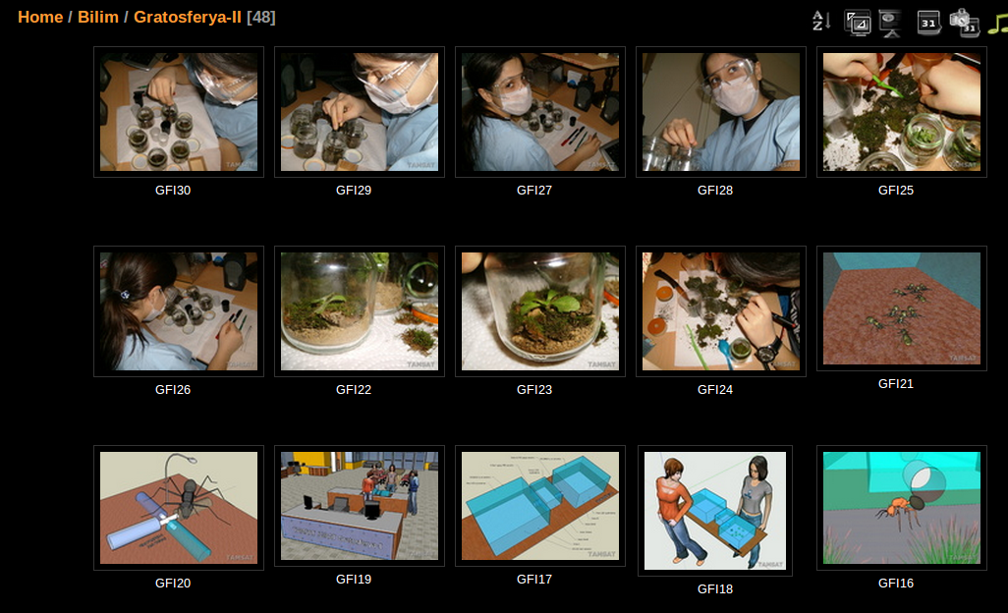
ACTIVITIES in TAMSAT
Notes:
Gratosferya project for searching extra terrestrial life outside the athmospher.
The basic idea was to collect samples from outer space using tubes send to trophosper with balloon
This was a brilliant idea but the English Scientiests achieved this goal before our youngs

Slide 15
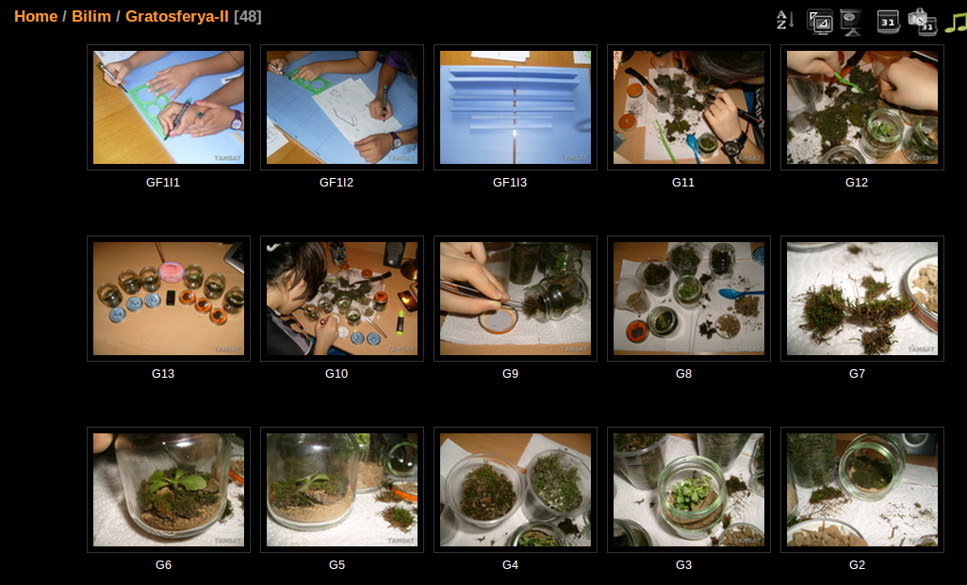
ACTIVITIES in TAMSAT
Notes:
They show that there might be extra terrestrial life in space by finding micro organizms outside of the athmospher which cannot be rised from the earth

Slide 16
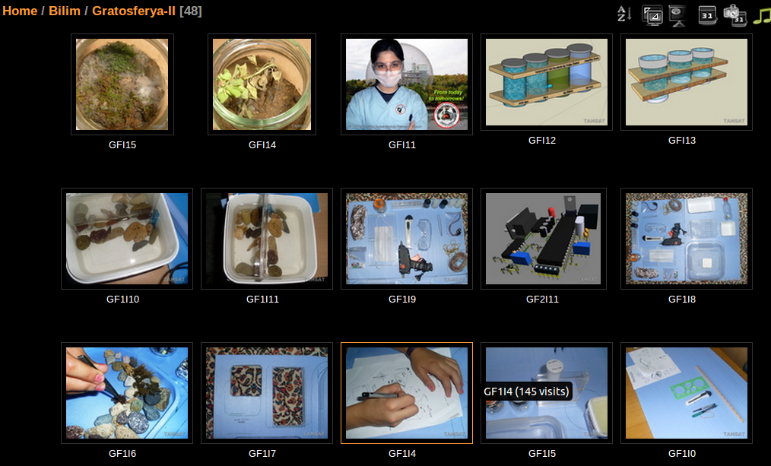
ACTIVITIES in TAMSAT
Notes:
And here some photos from same project

Slide 17
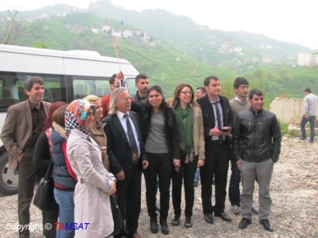

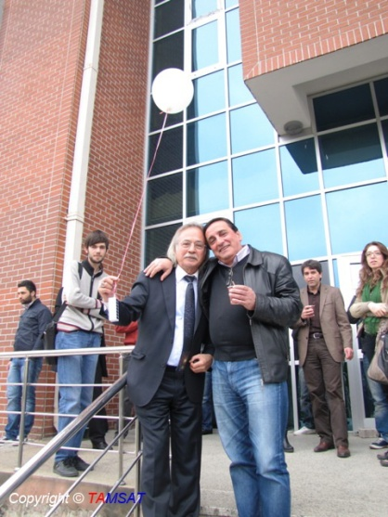
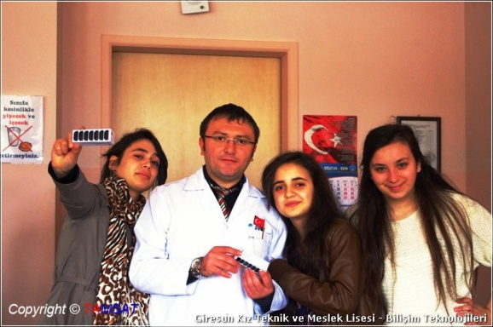
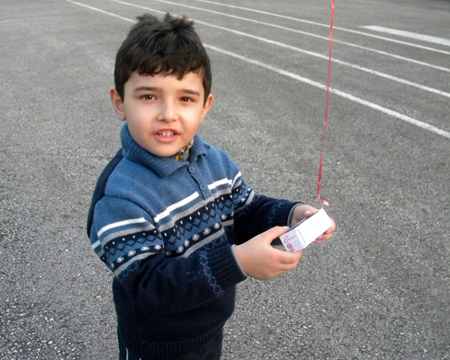
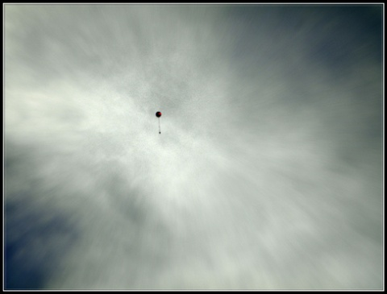
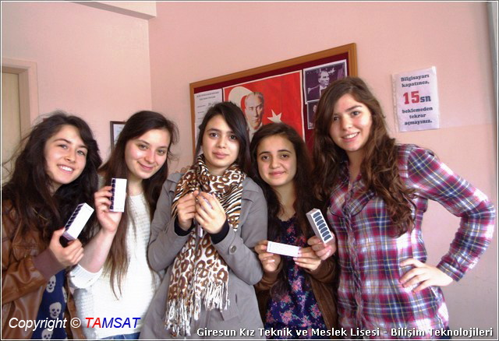
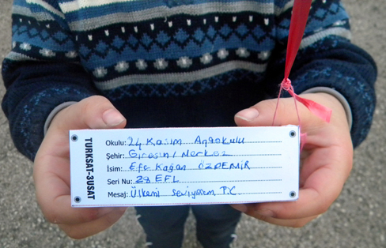
ACTIVITIES in TAMSAT
Notes:
This is our favorite in Giresun Keşap we trained preminary and high school students about satellite and space technologies with the help of our member Professor Doctor Ethem Derman who is a retiered astronomer and Ruha Uslu
Also we held a contest for the kids to send their own messages in to space with a balloon and a turksat three usat model

Slide 18
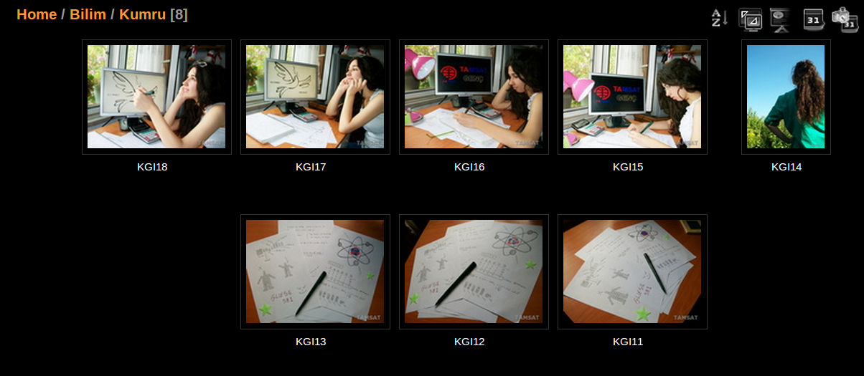
ACTIVITIES in TAMSAT
Notes:
These are some views from other projects

Slide 19
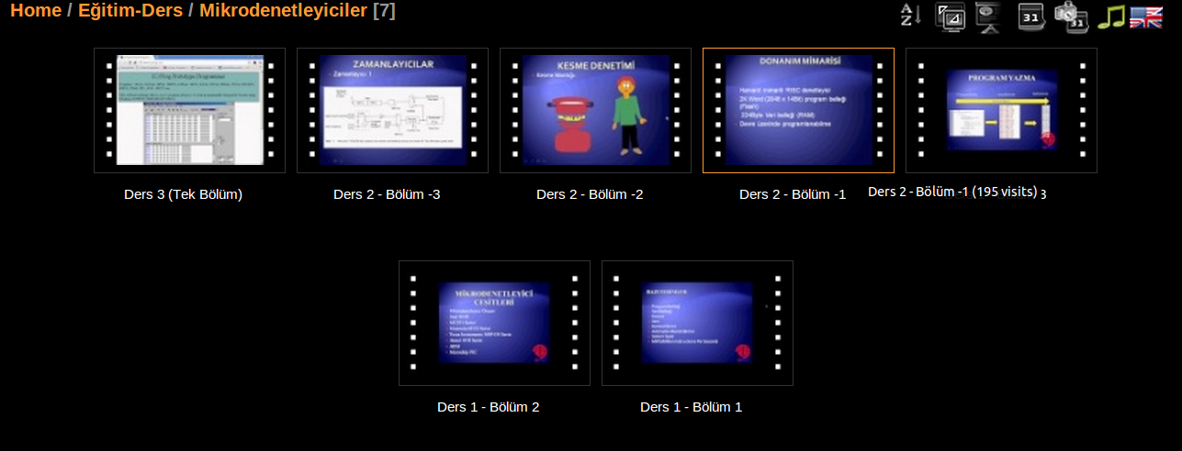
ACTIVITIES in TAMSAT
Notes:
These are some views from other projects

Slide 20
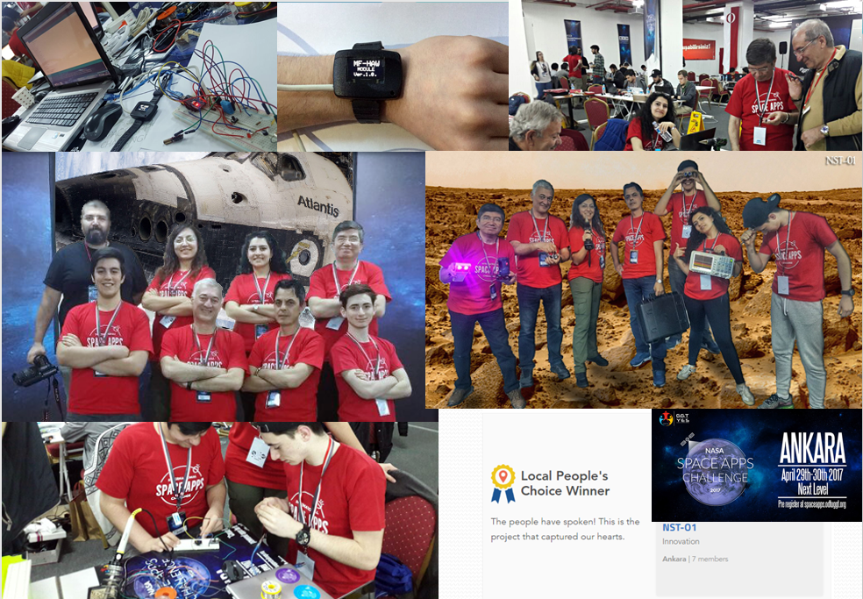
Notes:
Our latest activity was NASA Space Apps Challenge where our team designed presented and developed a multifunction human assistant watch and became the third group in the contest

Slide 21
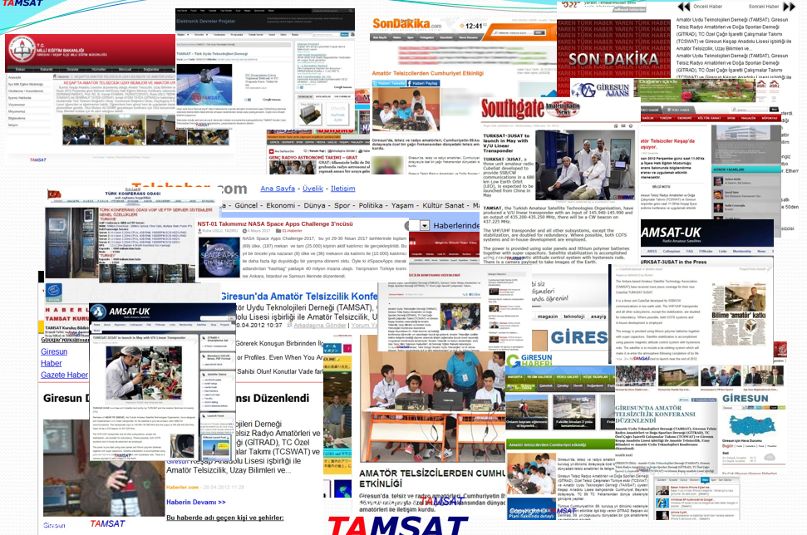
TAMSAT in Press
Notes:
These are some views from the press about our activities
It’s been only seven years but we did a lot
Now I want to leave the rest of the presentation to our vice president Mr Barış Dinç

Slide 22
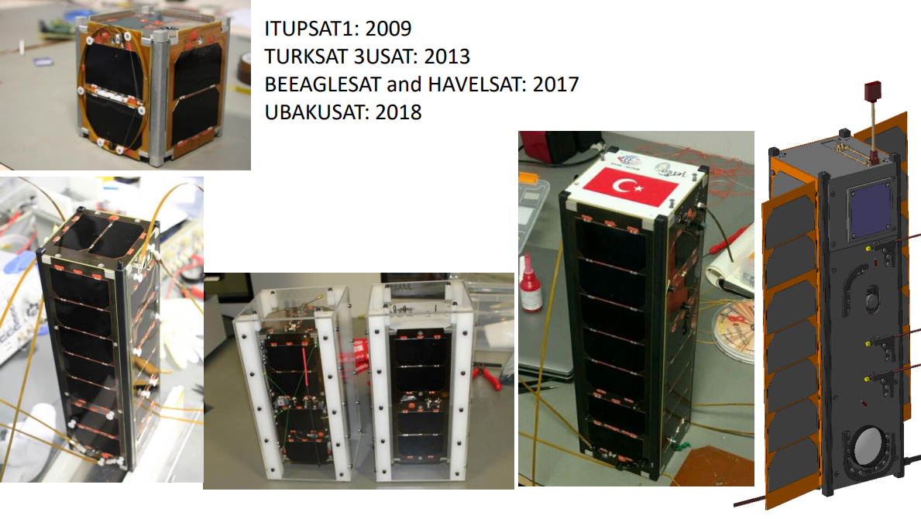
What is CUBESAT?

Slide 23
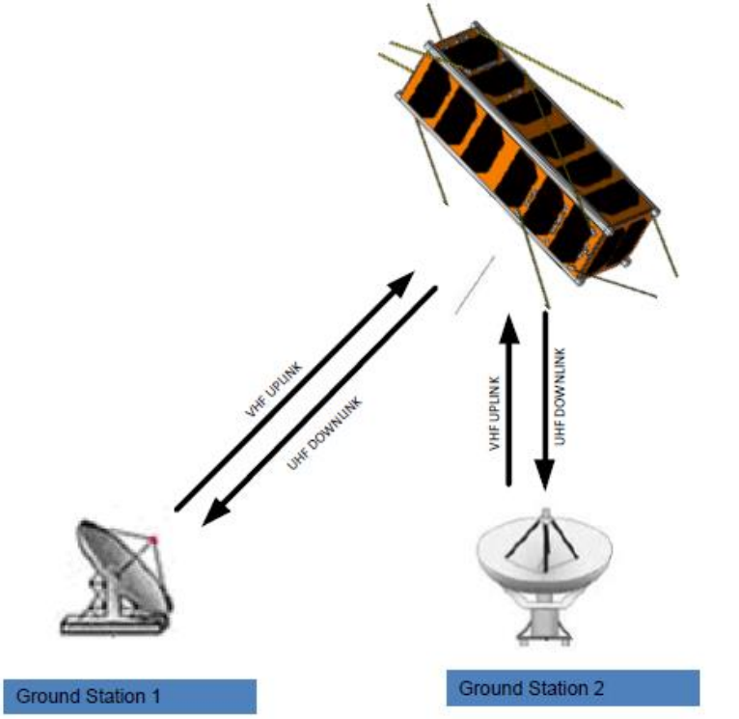
What is Satellite Communication?

Slide 24
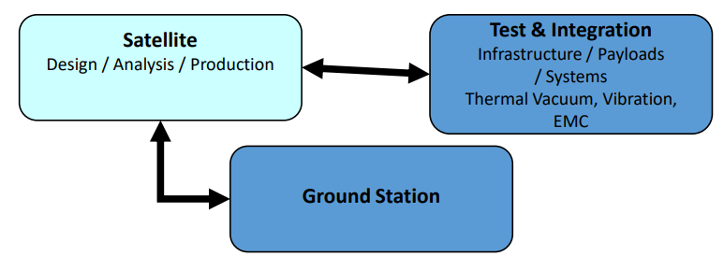
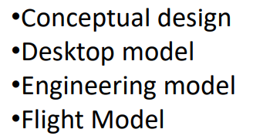
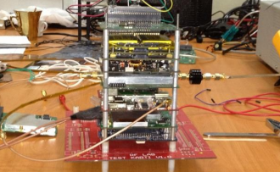
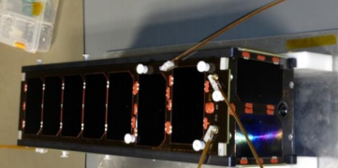
Satellite Subsystems

Slide 25
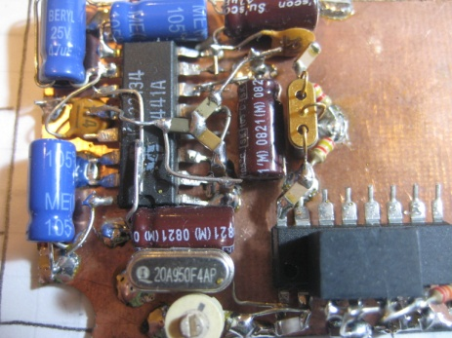
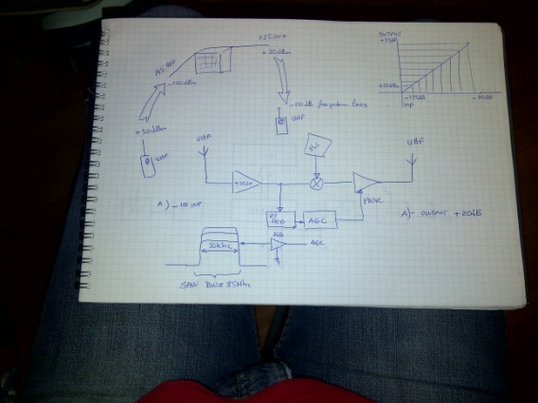
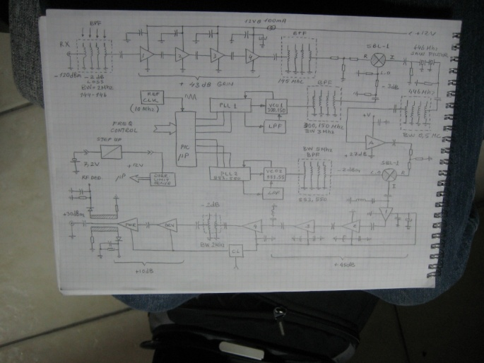
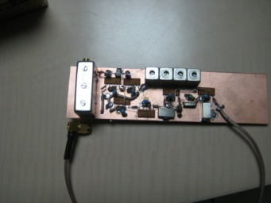
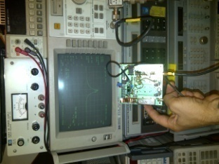
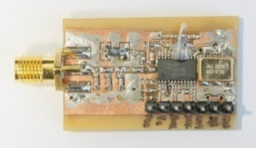
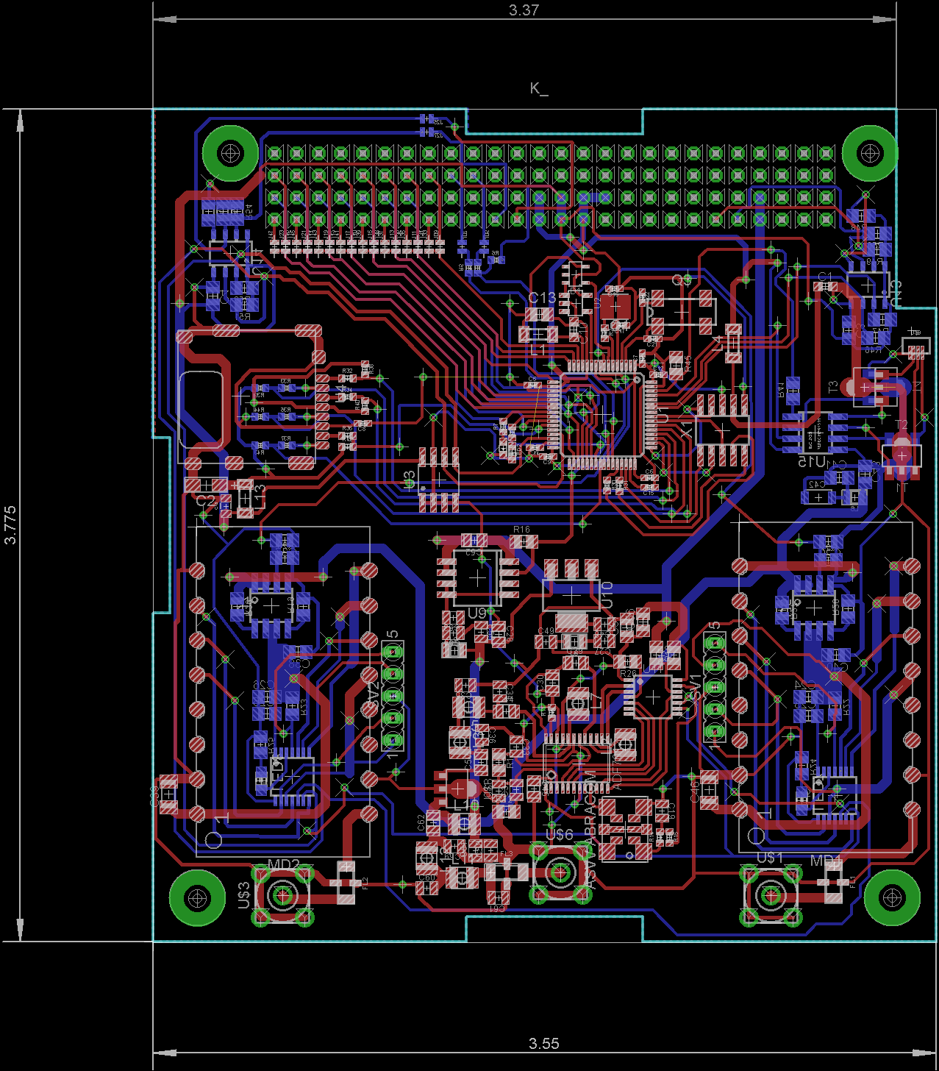
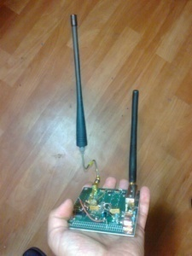
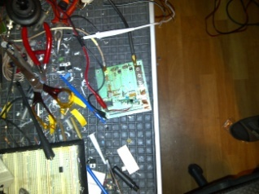
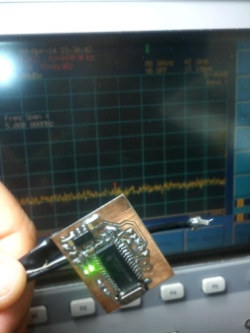
CUBESAT Project Lifecycle in TAMSAT
- Concept Of Operation
- Requirements
Preliminary Design
Preliminary Prototypes
Lab Tests
More Prototypes
Final Design

Slide 26
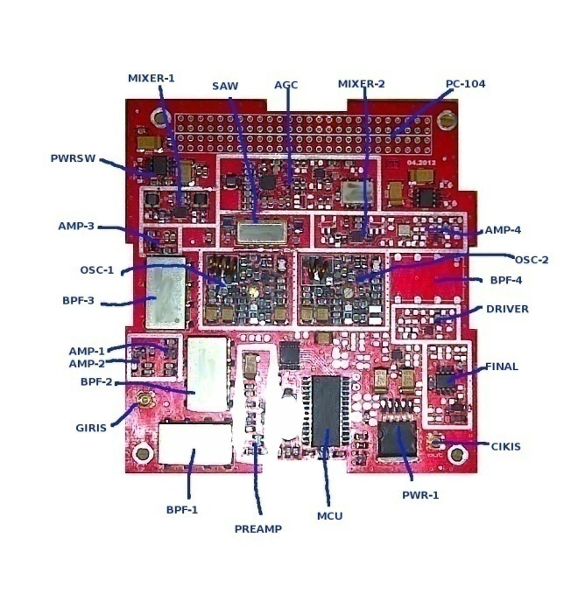
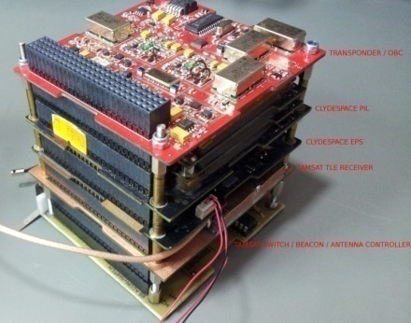
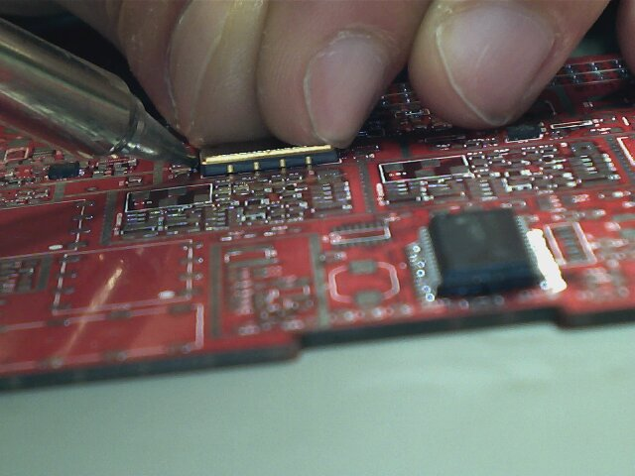
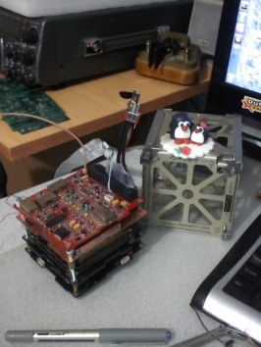
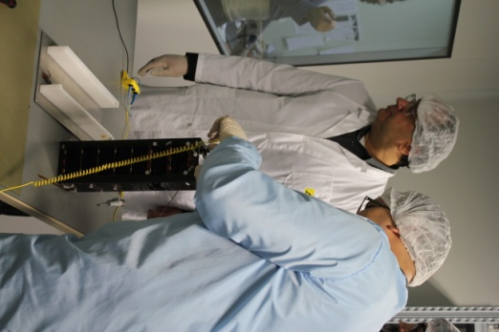
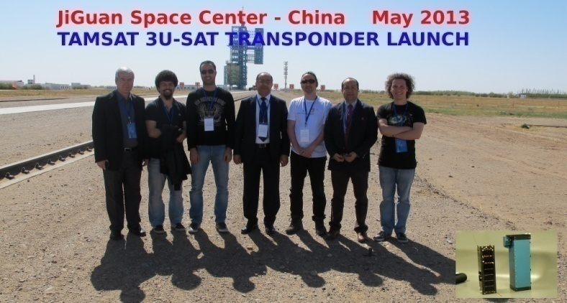
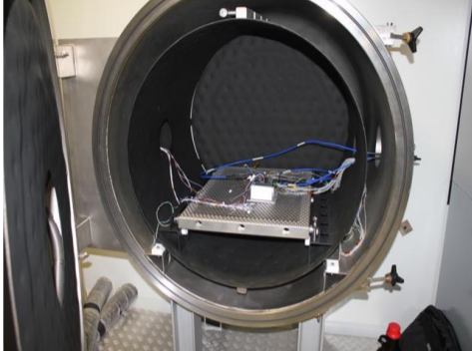
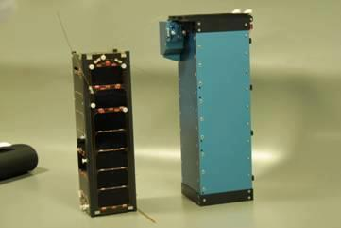
CUBESAT Project Lifecycle in TAMSAT
Production
First Prduct
Integration
Ready for Launch
Journey to Space
Final Space Tests

Slide 27
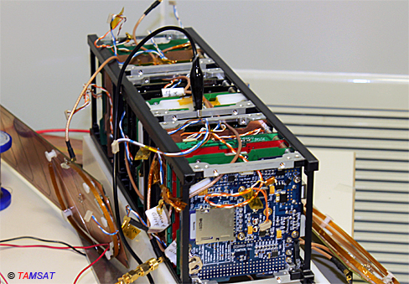
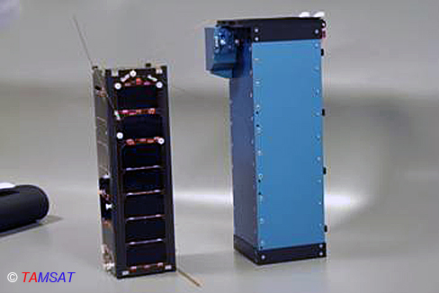
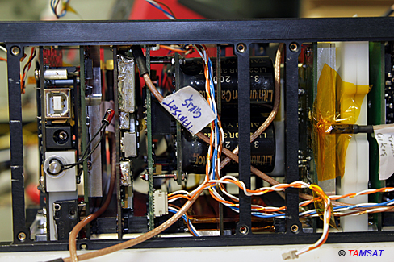
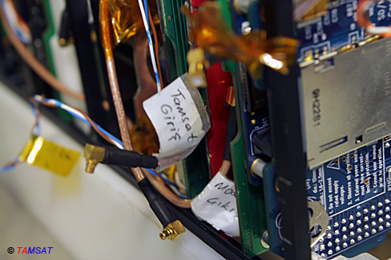


TURKSAT 3USAT

Slide 28

ANATOMY of a CUBESAT

Slide 29


ANATOMY of a CUBESAT

Slide 30

CUBESAT BUS

Slide 31



CUBESAT PINOUT STANDARD

Slide 32

THE STRUCTURE (SKELETON)

Slide 33

OBC & BEACON

Slide 34

OBC & BEACON

Slide 35


Slide 36

BEACON

Slide 37

ANTENNA OPENING SUBSYSTEM

Slide 38

PAYLOAD-1 (TRANSPONDER)

Slide 39

PAYLOAD-1 (TRANSPONDER)

Slide 40


FREE SPACE LOSS
300 Mhz FSL
50km | 116dB
100km | 122dB
150km | 125.5dB
200km | 128dB
250km | 129.9dB
300km | 131.5dB
350km | 132.9
400km | 134dB
450km | 135dB

Slide 41

PAYLOAD-2 (TAMSAT MicroSAT)

Slide 42

STABILIZER

Slide 43

THE MASS MATTERS

Slide 44

TAMSAT PROJECTS FOR
CUBESATS

Slide 45

TAMSAT IHU
Internal Housekeeping Unit

Slide 46


TAMSAT Transponder

Slide 47

TAMSAT OBC

Slide 48

TAMSAT BEACON

Slide 49
TAMSAT SATELLITE TRACKING NETWORK
Based on volunteers and TAMSAT members all around the world
Supports Hamradio and Educational satellite missions
Collects data for further analysis by satellite operators
Experimenting and documenting satellite communication systems
Enhancing digital modes

Slide 50




Slide 51





Slide 52




Slide 53




Slide 54




Slide 55




Slide 56




Slide 57
WHO WE ARE?
A group of “DAYDREAMERS” who like
living within TECHNOLOGY
And develop solutions for every issue.
Our goal is to make our DREAMS REAL
«WE ARE MUCH MORE POWERFULL TOGETHER»

Slide 58

THANKS

